Slide 1
Survey of RDBMS vs. Graph Database Performance Using Time Series Data Manipulation
Paul Marquardt and Kristen Rollins

Slide 2
Problem Statement
We will test the suitability of an RDBMS system to manipulate times series data versus a graphing database to compare performance statistics.

Slide 3

Domain – Stock Data
American stock exchanges
Amex, Nasdaq, NYSE

Slide 4
Application – Volatility Index Rating
Volatility Index (VIR)
“Volatility Index Graph”
Formula over previous 22 days:
VIR = (Highest Close – Current Close) / (Highest High) * 100

Slide 5
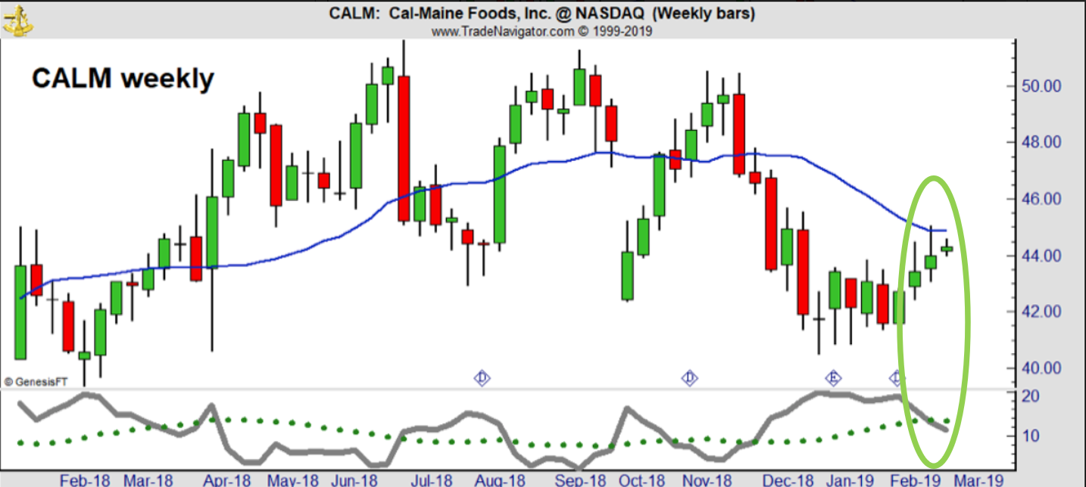
Application – VIR

Slide 6
Obtaining Data
www.nasdaq.com for symbols and company info
Python script to pull historical data
Uses pandas_datareader library
Defines start/end dates
Appends Yahoo stock data to csv file

Slide 7
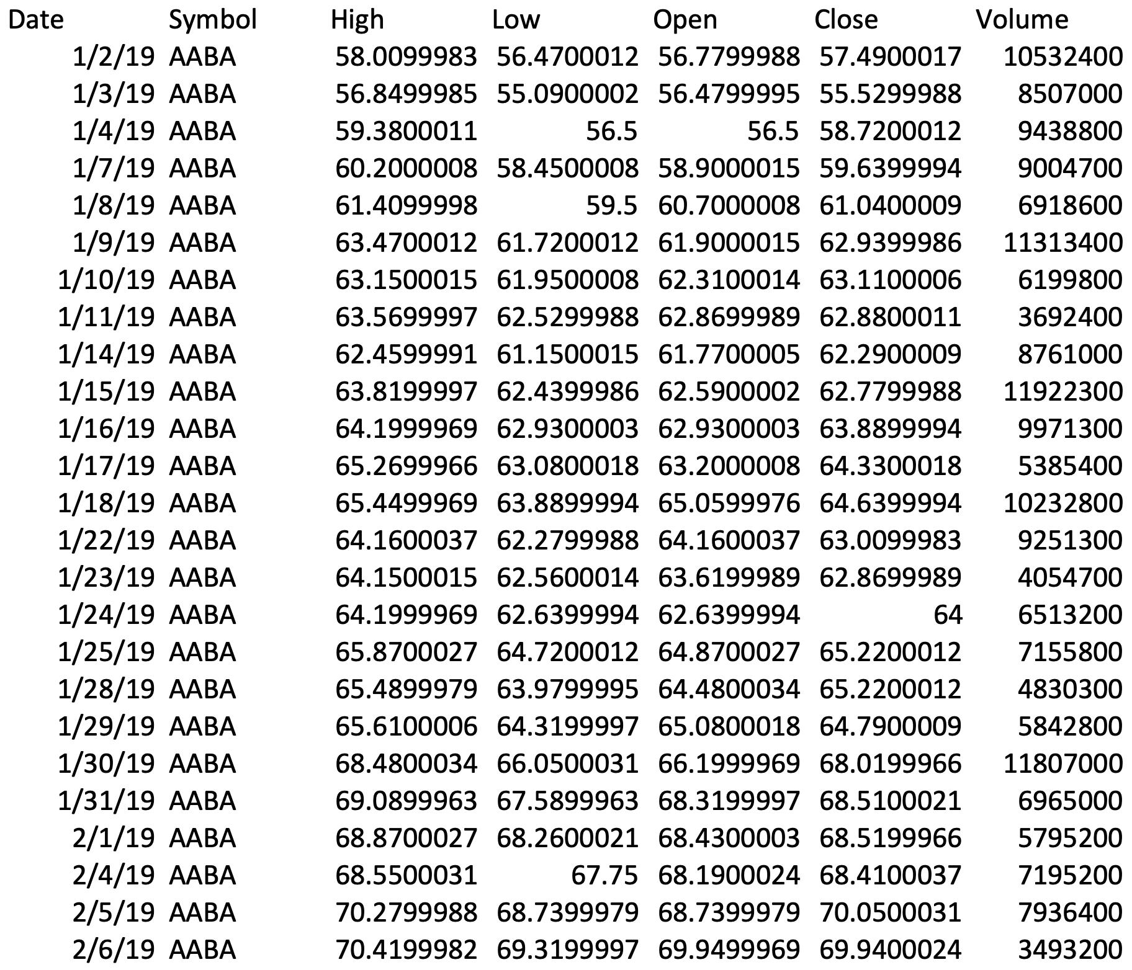
Raw Data

Slide 8
Raw Data
Date range: 9/1/2018-3/21/2019
Amex – 3.5 MB
37k rows
NYSE – 34 MB
348k rows
Nasdaq – 43 MB
433k rows

Slide 9
Objectives
For MySQL and Neo4j:
Create data model
Import stock data
Calculate VIR
Obtain performance metrics

Slide 10

MySQL
Chosen relational DBMS
Familiar and free
Expectations
Not suitable for time series data
Slow queries (lots of joins)

Slide 11
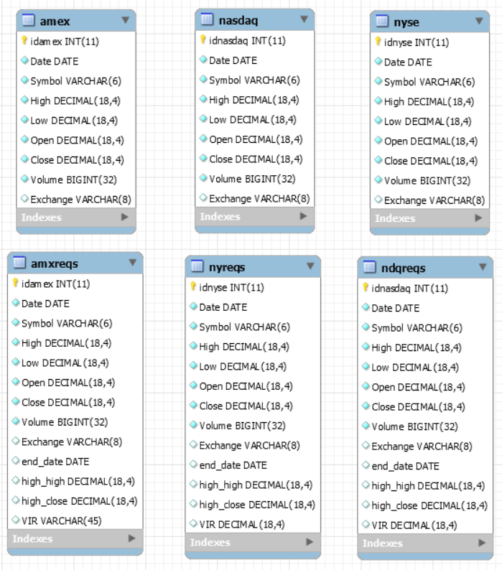
MySQL Data Model

Slide 12

Neo4j
Chosen graph DBMS
Most popular graph database
Open source
Expectations
More appropriate representation
Faster queries

Slide 13
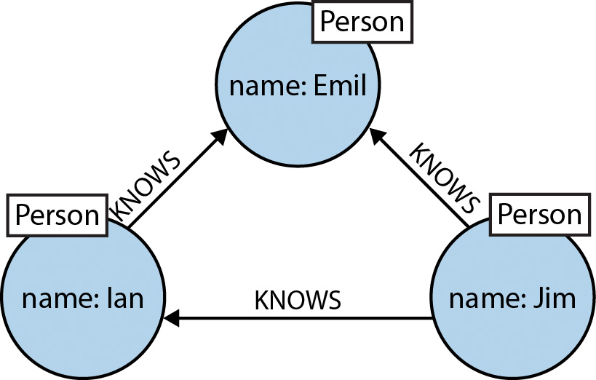
Neo4j Basics
Data constructs:
Nodes
Relationships
Properties
Labels
Neo4j reference: Learning Neo4j 3.x, 2nd edition by Baton and Bruggen

Slide 14
Cypher Basics
Create – Create
Read – Match, Where, Return
Update – Set, Remove
Delete – Detach, Delete
Basic structure (read):
MATCH (m:Label1)-[:Relation]->(n:Label2)
RETURN m,n

Slide 15
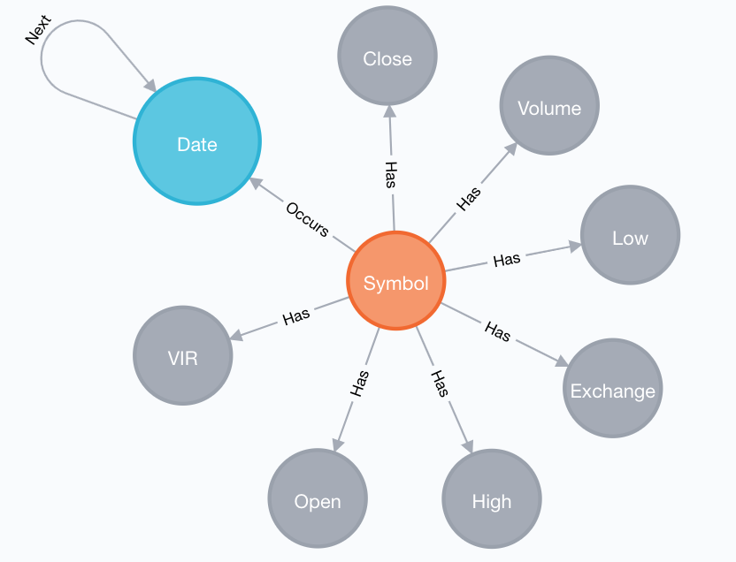
Neo4j Data Model

Slide 16
Neo4j Data Import
Load dates
Link dates together
Load remaining data:
using periodic commit
load csv with headers from
'file:///amex_03-21-2019.csv' as line
match (d:Date{name:line.Date})
create (s:Symbol{name:line.Symbol}),
(s)-[:Occurs]->(d),
(s)-[:Has]->(:High {name:toFloat(line.High)}),
(s)-[:Has]->(:Low {name:toFloat(line.Low)}),
(s)-[:Has]->(:Open {name:toFloat(line.Open)}),
(s)-[:Has]->(:Close {name:toFloat(line.Close)}),
(s)-[:Has]->(:Volume {name:toInteger(line.Volume)}),
(s)-[:Has]->(:Exchange {name:line.Exchange})

Slide 17
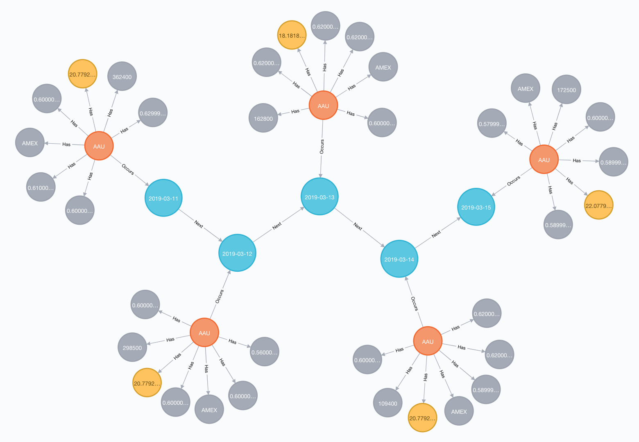
Neo4j Example Data

Slide 18
Neo4j Example Data
Cypher query:
match (d:Date)-[:Occurs]-(s:Symbol)-[:Has]-(p)
where (d.name>="2019-03-11"
and d.name<="2019-03-15") and s.name="AAU"
return d,s,p

Slide 19
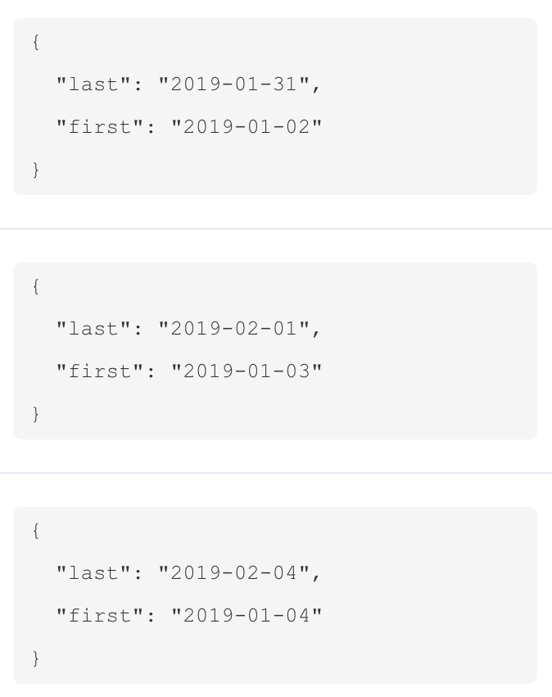
Neo4j VIR Calculation
Complicated query!
Basic idea:
Pair dates with 20 days between
Match all symbols
Get max close, current close, max high
Make the calculation
Create new VIR node

Slide 20
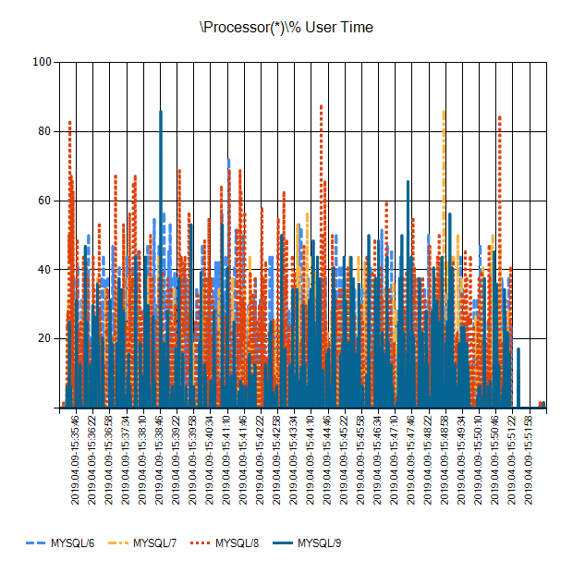
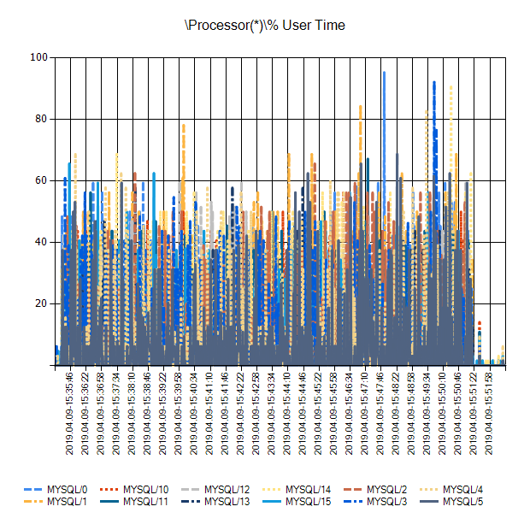
Amex Results

Slide 21
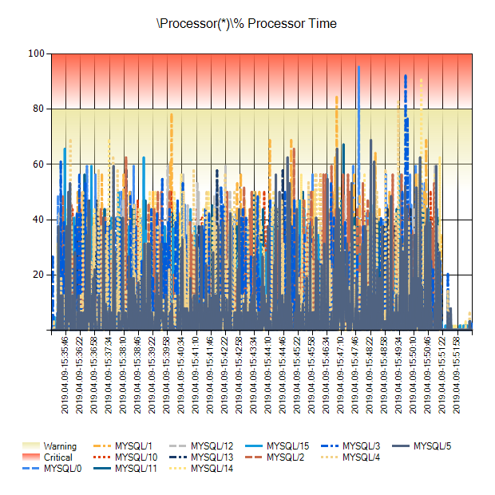
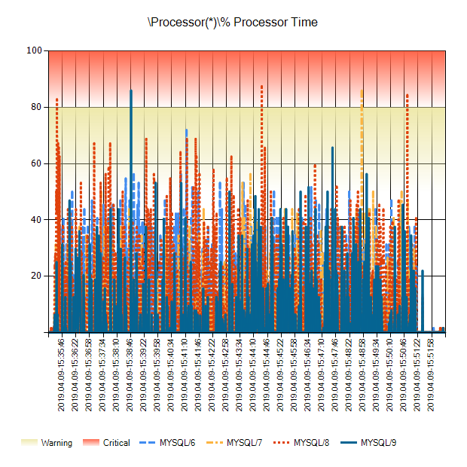
Amex Results

Slide 22
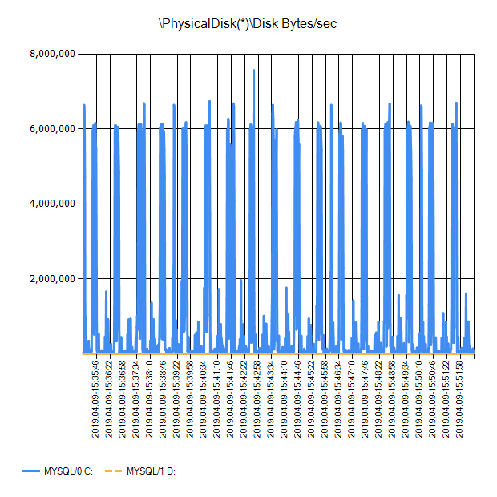
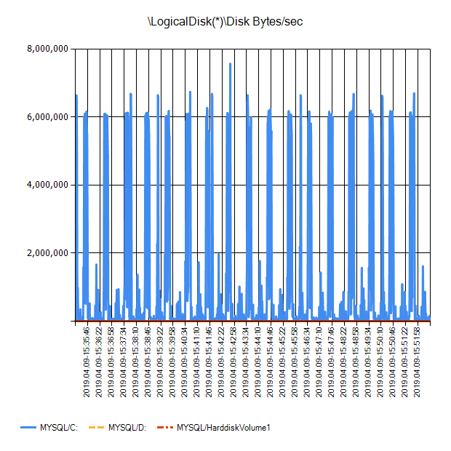
Amex Results

Slide 23
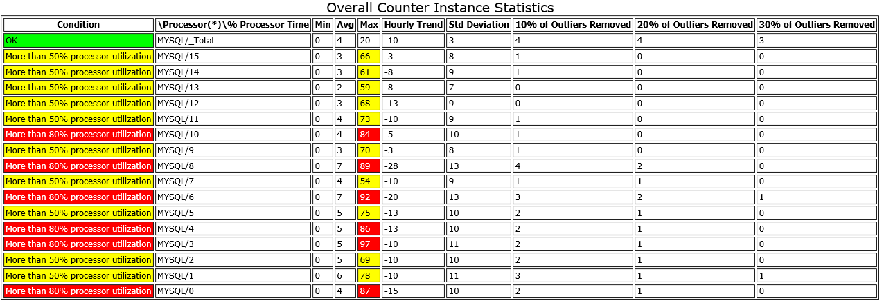
Amex Results

Slide 24
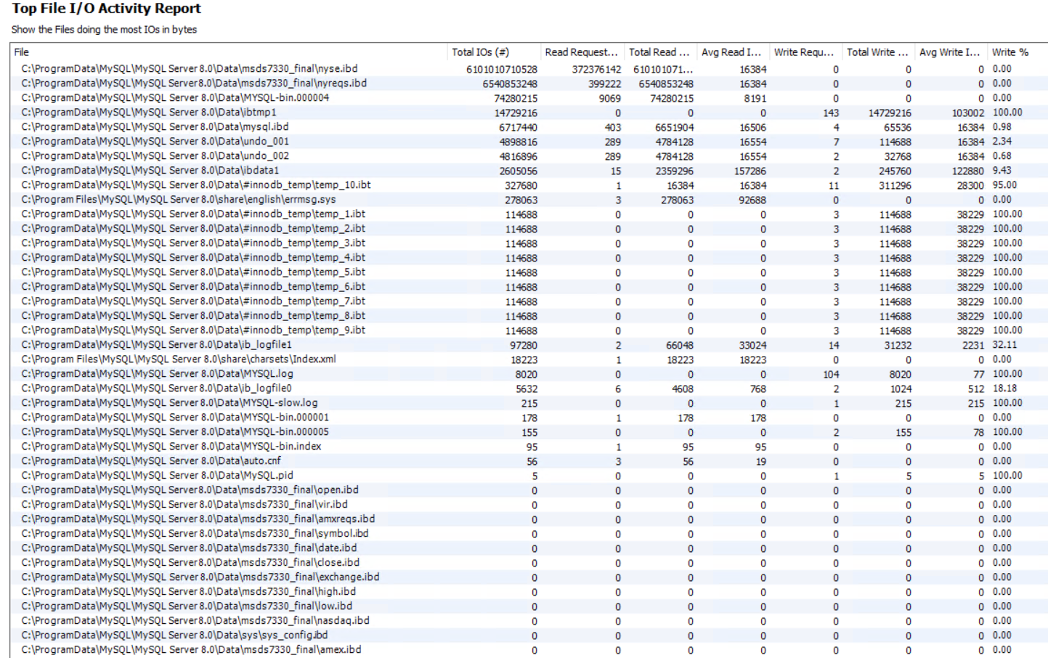
I/O Results

Slide 25
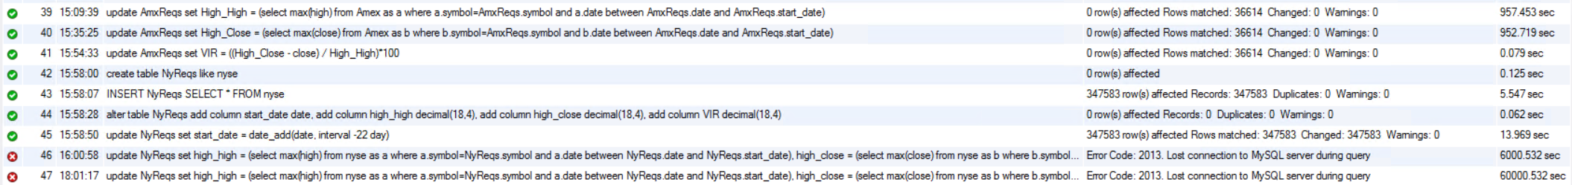
NYSE Results
MySQL
Timed out after 60k seconds (~17 hours)
Neo4j
Currently running

Slide 26
Final Steps
Finish NYSE/Nasdaq calculations
Attempt query optimization
Complete analysis
Questions?

